Slide 1
Machine Learning - Data, Model and Loss
Alexander Jung
Associate Professor for Machine Learning
Department of Computer Science
Aalto University

Slide 2




About me.
2012: Phd in Electrical Engineering, TU Wien
2012 – 2015: Post-Doc TUW, ETH Zurich
2015 - : Prof. for ML @ Aalto
2019- : Instructor at Aalto EE
2022 -: Principal AI Scientist at Silo AI

Slide 3
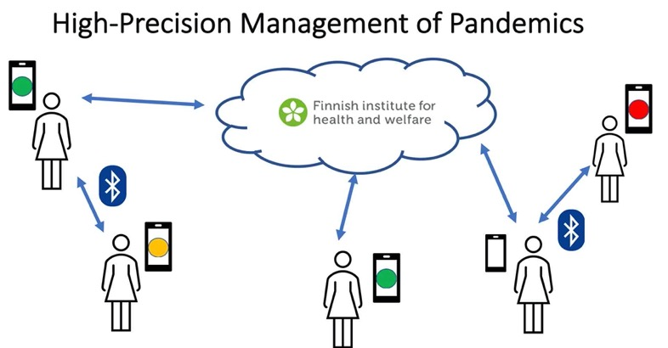
RA1: Networked Federated Learning.
Y. Sarcheshmehpour, M Leinonen and AJ, “Federated Learning From Big Data Over Networks”, IEEE ICASSP, 2021.
AJ, “Networked Exponential Families for Big Data Over Networks,” in IEEE Access, 2020, doi: 10.1109/ACCESS.2020.3033817.
AJ, N. Tran, “Localized Linear Regression in Networked Data,” in IEEE SPL, 2019, doi: 10.1109/LSP.2019.2918933.
Notes:
Our current research focus is two areas. The first research area is federated mutl-task learning which is relevant e.g. for the high-precision management of pandemics. Indeed, the personalized predicition of infection risks results in a networked collection of individual learning tasks. Each single task corresponds to learning accurated infection risk predictors for a particular person. I will talk more about how the statistical and computational aspects of such federated multit-task earning problems udring the main part of my talk.

Slide 4
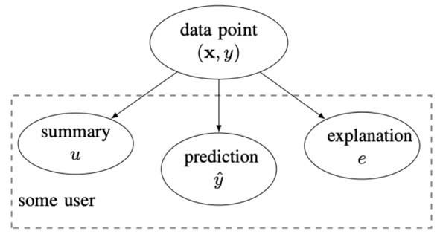
RA2: Explainable Machine Learning.
explanation can be:
relevant example of training set
subset of features
counterfactuals
a free text explanation
court sentence
AJ, “Explainable Empirical Risk Minimization”, arXiv eprint, 2020. weblink
AJ Jung and P. H. J. Nardelli, “An Information-Theoretic Approach to Personalized Explainable Machine Learning,” in IEEE SPL, 2020, doi: 10.1109/LSP.2020.2993176.
Notes:
Our second current research area is explainable machine learning. Our take on this hot topic is to measure the usefulness of an explanation by the amount by which the entropy of the prediction is reduced. An explanation can be any artefact that is revealed together with the prediction. For example, an explanation could amount to selecting a particular training example. Another form of explanations is obtained by listing a set of most relevant features. Formally, we model the explanation and prediction as correlated random variables. This information-theoretic approach is appealing as it allows to take into account the user background knowledge. We characterize the user background by a user summary that is provided by a training set. We use the user summary to design explanations that maximally reduce the uncertainty about a prediction for a specific user.

Slide 5

Regulating/Using ML needs a handy language!
https://aaltodictionaryofml.github.io/ADictML.pdf

Slide 6
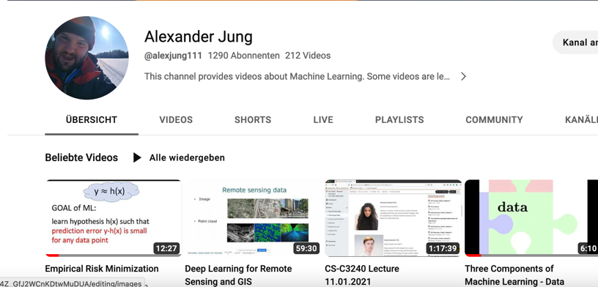
Machine Learning YouTube.
https://www.youtube.com/channel/UC_tW4Z_GfJ2WCnKDtwMuDUA

Slide 7
Learning Goals Today
develop intuition for how ML works
become familiar with concept of data points
…with concept of a model
…with concept of a loss function

Slide 8
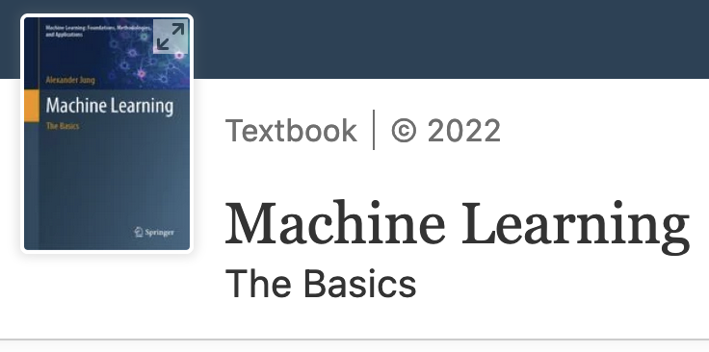
Based on Ch. 1 -3 of
preprint: mlbook.cs.aalto.fi

Slide 9
What is all About ?
fit models to data to make predictions or forecasts !

Slide 10
1. element
2.
3.
4.
5.
6.
4, 5, 6, 7, 8, ?
“data point”
Notes:
Let me start to explain what generalization is with the help of a game that many of you might have come across already. The game consists of extending a given sequence of objects, e.g., a sequence of numbers. In machine learning we often refer to these individual objects as data points.
Here we have a sequence of five numbers, 4, 5, 6, 7, 8 and the goal is to guess or predict the next element in the sequence. Generalization here means to be able to produce a good guess for the next element in the sequence.

Slide 11
“features”
1
1
1
“label”
1/2
1
?
Notes:
Let us consider another instance of the sequence guessing game. In contrast to the previous game, here the sequence elements consist of two parts. The first part, which is known as the features of a data point, is a geometric figure. The second part of each sequence element is a number, the label of this element. Here, the goal is to guess the label of a new sequence element for which we are given the features.

Slide 12
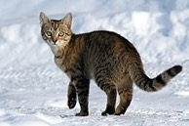

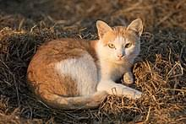

features (pixel RGB values)
“Cat”
“Dog”
“Cat”
?
label
https://commons.wikimedia.org/
Notes:
Here is another instance of the sequence guessing game. This guessing game here depicts one of the most popular applications of modern machine learning, i.e., to predict if a given image shows a cat or if the image shows a dog. Machine learning methods solve this task by playing a sequence extension game. These methods are provided a typically very large number of sequence elements for which the label is known. One key factor for the success of modern machine learning methods is the availability of large amounts of labeled sequence elements or training data.

Slide 13

“feature”
data point
min tmp: -10
max tmp: -3
min tmp: -3
max tmp: 4
min tmp: 1
max tmp: 5
min tmp: -6
max tmp: ?
“label”
Notes:
Here is another instance of the game which could be useful for developing a machine learning method that allows to predict the maximum daytime temperature based on the minimum daytime temperature. This might be useful if you plan a ski trip during some winter day in Finland.

Slide 14
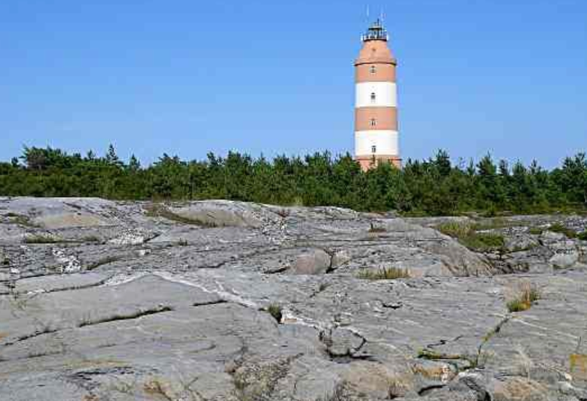
Where?

Slide 15
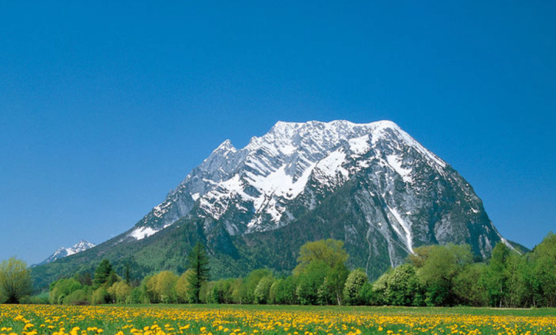
Which mountain?
Which month?

Slide 16
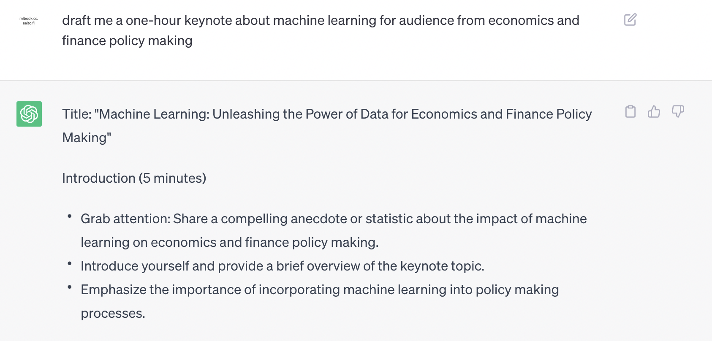

Slide 17
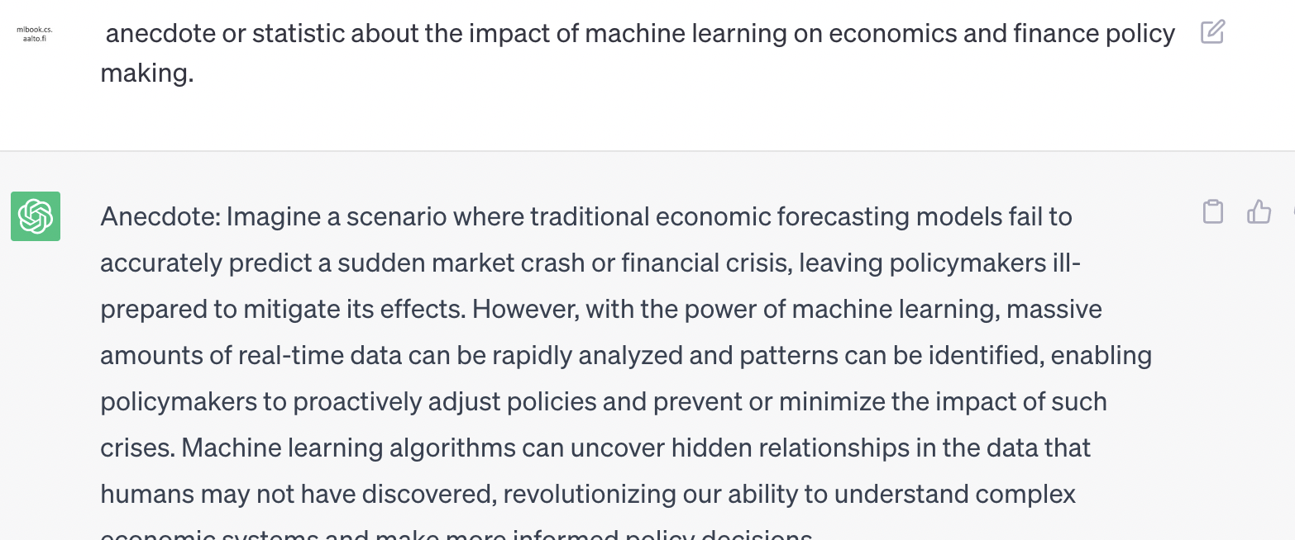

Slide 18
so, how does it work?
Notes:
now that we have looked at several instances for the sequence guessing game, can we find some general approach or principle for solving them? Machine learning, like human learning, uses a simple but powerful principle to solve any kind of sequence guessing games. This principle is based on forming a hypothesis.

Slide 19
use hypothesis about data generation
to make predictions (forecasts)
Notes:
Machine learning methods learn a hypothesis for the intrinsic structure in observed data. Using this hypothesis, predictions about new elements or future events can be made.

Slide 20
4, 5, 6, 7, 8, ?
“hypothesis”
Notes:
Consider again the sequence we have already shown before. This sequence starts with five numbers, 4, 5, 6, 7, 8. The question is then what could be a good guess for the next element in the sequence. Just by looking at the first five number, many of you might have formed immediately a hypothesis. This hypothesis might be that the sequence elements are linearly increasing according to a straight line. Using this hypothesis, we can predict the next element by continuing the straight line.

Slide 21
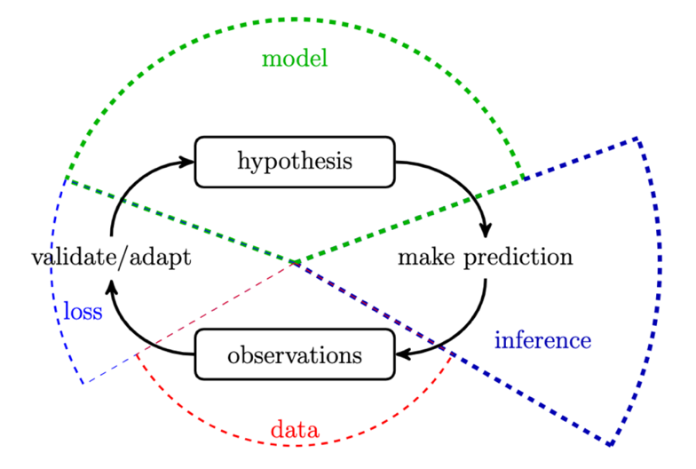
“Life-Long Learning”
Notes:
Machine learning methods learn a hypothesis for the intrinsic structure in observed data. Using this hypothesis, predictions about new elements or future events can be made.

Slide 22
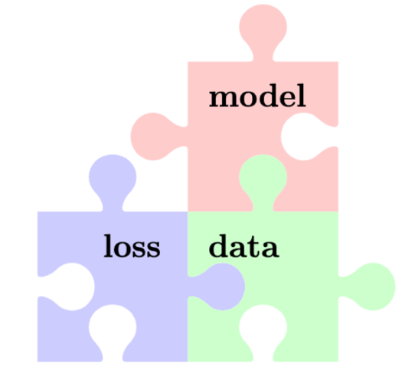
Three Components of ML

Slide 23
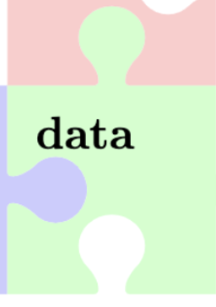
“What I’m finding is that for a lot of problems, it’d be useful to shift our mindset toward not just improving the code but in a more systematic way of improving the data,” said Andrew Ng
https://read.deeplearning.ai/the-batch/issue-84/

Slide 24
data = set of datapoints

Slide 25
What is a Datapoint?
some object that might carry relevant
information

Slide 26
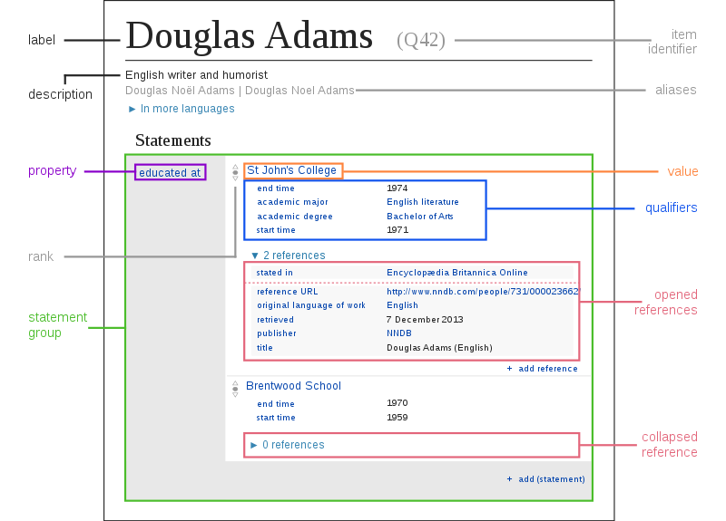
Datapoint = Some Item in Wikidata
https://upload.wikimedia.org/wikipedia/commons/a/ae/Datamodel_in_Wikidata.svg

Slide 27
Datapoint = Some Period of Time
1.1.2020 01:00 - 2.1.2020 13:00

Slide 28

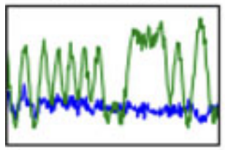
Datapoint = Some Wireless Signal
T. J. O’Shea, T. Roy and T. C. Clancy,
"Over-the-Air Deep Learning Based Radio Signal Classification,"
in IEEE Journal of Selected Topics in Signal Processing, vol. 12, no. 1, pp. 168-179, Feb. 2018,
doi: 10.1109/JSTSP.2018.2797022.

Slide 29

Datapoint = Some Country

Slide 30
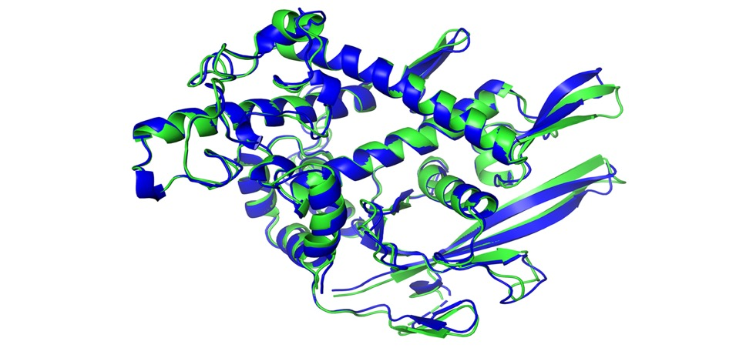
Datapoint = Some Protein

Slide 31
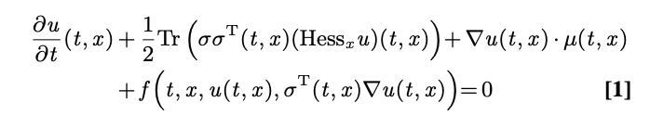
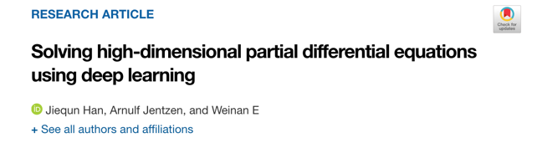
Datapoint = A Partial Differential Equation
https://www.pnas.org/content/115/34/8505/tab-article-info

Slide 32
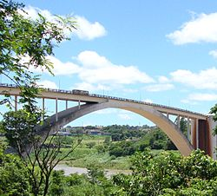
Datapoint = Some Bridge
https://commons.wikimedia.org/wiki/Category:Bridges

Slide 33
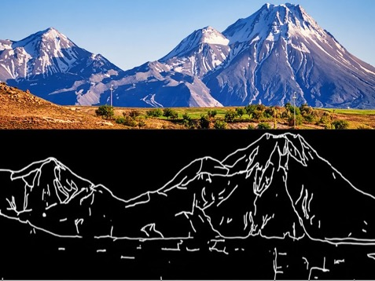

Datapoint = Image Sketch
https://ml4a.net/

Slide 34
Features and Labels.

Slide 35
datapoint characterized by
features: low-level properties; easy to measure/compute
labels: high-level quantity of interest; difficult to measure/determine

Slide 36
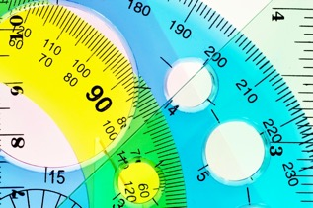



Numeric Features
we mainly use numeric features
x1,…,xn to characterize a datapoint
stack features into feature vector
Python: use numpy array to store features
discuss feature learning methods later

Slide 37
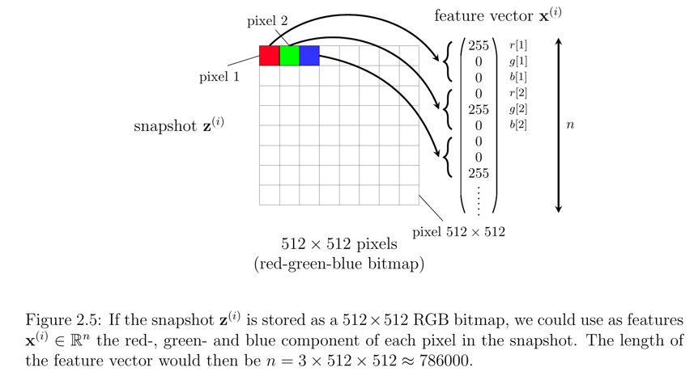
Features of an Image.

Slide 38
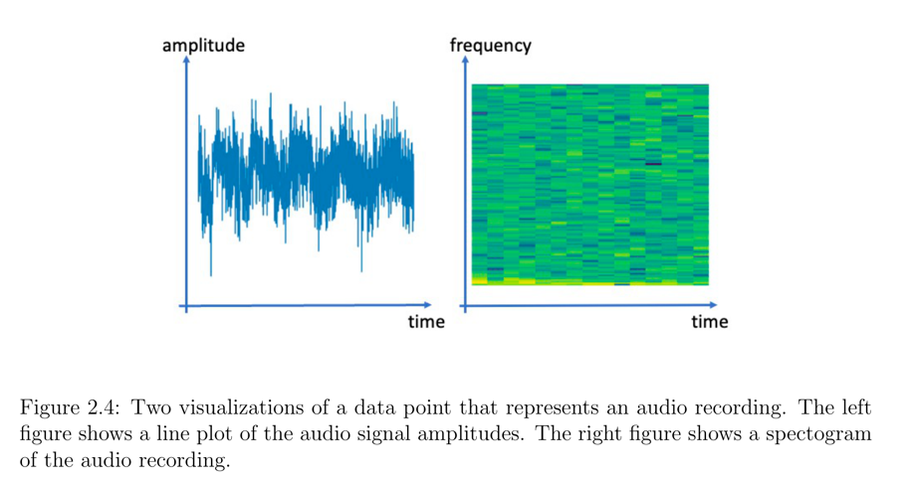
Features of an Audio Recording.

Slide 39
Datapoint = Period of Time
1.1.2020 00:00 - 1.1.2020 23:55
features: temperature recordings @ 01:00, 03:00, 05:00
label: temperature recording @ 23:00

Slide 40
Datapoint = Wireless Signal
features:
label:
T. J. O’Shea, T. Roy and T. C. Clancy,
"Over-the-Air Deep Learning Based Radio Signal Classification,"
in IEEE Journal of Selected Topics in Signal Processing, vol. 12, no. 1, pp. 168-179, Feb. 2018,
doi: 10.1109/JSTSP.2018.2797022.

Slide 41

Datapoint = A Protein
features:
label:

Slide 42
Datapoint = A Partial Differential Equation
features:
label:
https://www.pnas.org/content/115/34/8505/tab-article-info

Slide 43
Datapoint = A Bridge
features:
label:
https://commons.wikimedia.org/wiki/Category:Bridges

Slide 44
Datapoint = Image Sketch
features:
label:
https://ml4a.net/

Slide 45
Datapoints, their Features and
Labels are Design Choices!

Slide 46
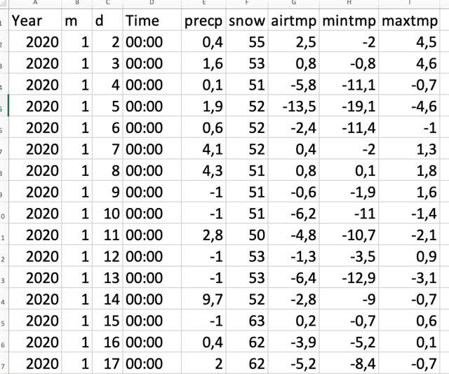
raw data from FMI
https://en.ilmatieteenlaitos.fi/download-observations

Slide 47
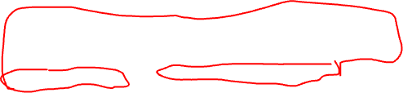
features
label
data point
data point, features and label
are design choices!

Slide 48
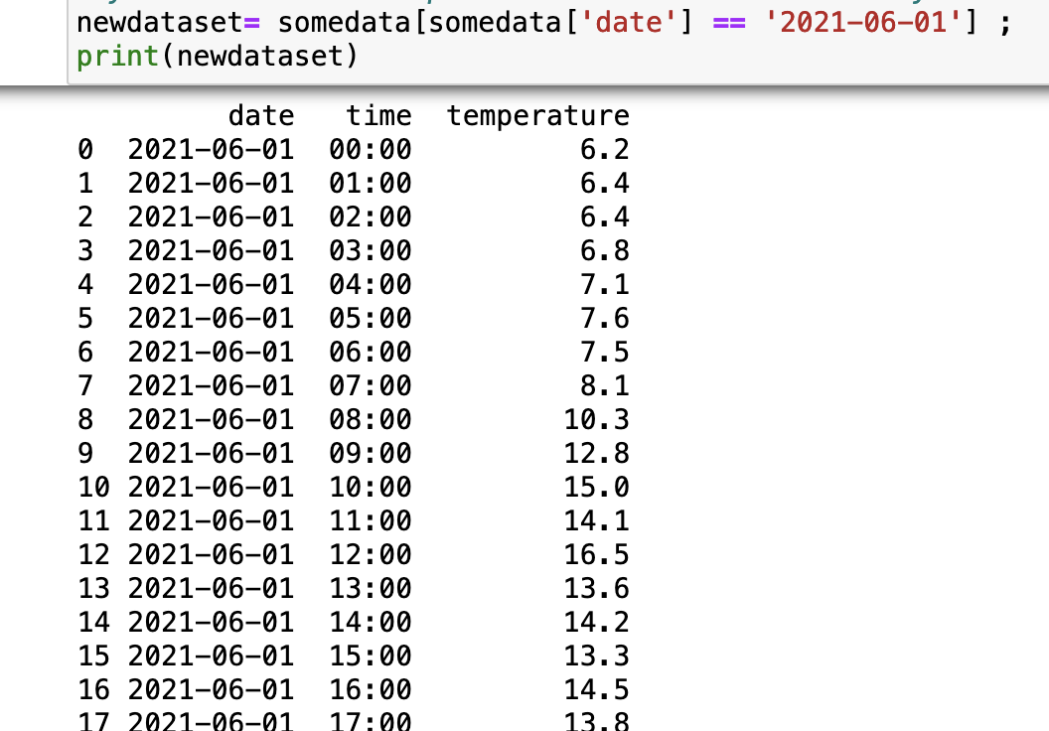

Slide 49
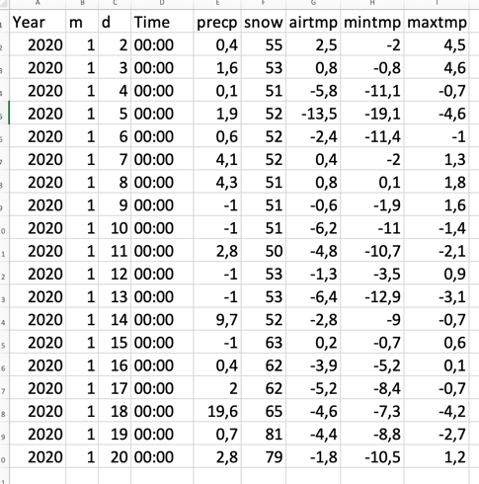
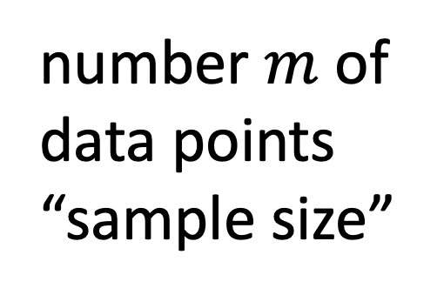
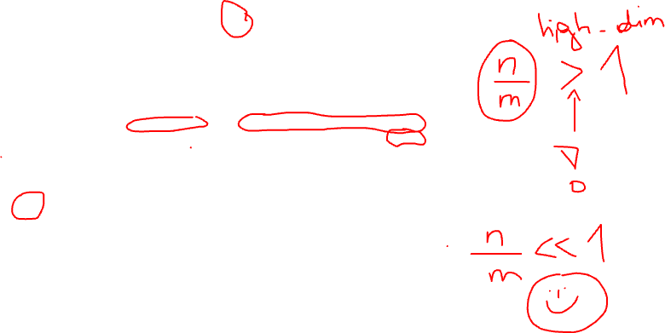
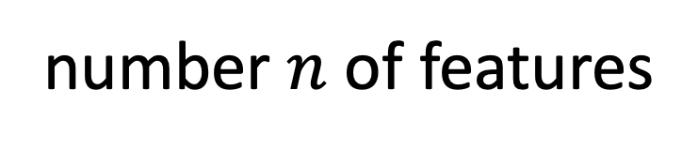
Key Parameters of a Data Set
number $n$ of features
number $m$ of data points
“sample size”

Slide 50
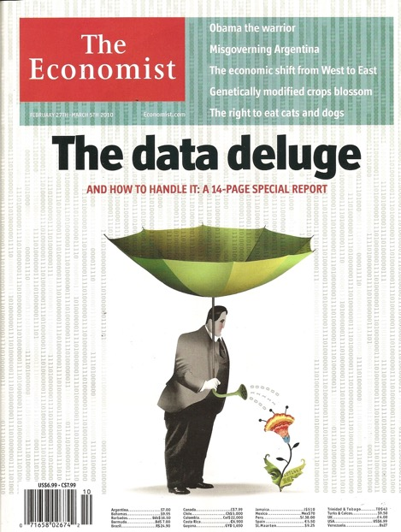
Feature Deluge.
modern information technology provides huge
number of raw features
smartphones
webcams
social networks
smart watch
….

Slide 51
use only most relevant features but not fewer.
missing relevant features bad for accuracy
using many irrelevant features wastes
computation and might result in overfitting

Slide 52

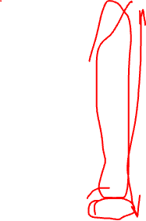

data point = some day at
FMI station
feature = nr of hourly observations
want to predict maximum daytime
temperature
missing relevant features bad for accuracy

Slide 53
data point = some day at
FMI station
feature = hourly temp. 00:00 – 15:00
want to predict temp at 16:00
using irrelevant features wastes comp. resources

Slide 54
Label is Design Choice!
YOU choose the label of a data point
by choosing/defining label you define
the ML problem or learning task !
Lecture continues at…

Slide 55
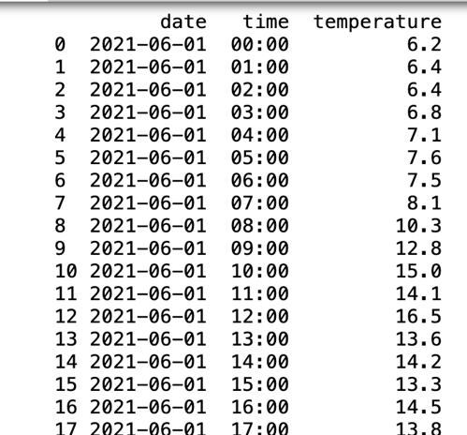
Regression. Numeric Labels.
datapoint
“2021-06-01 at some FMI station”
label = tmp at 15:00

Slide 56
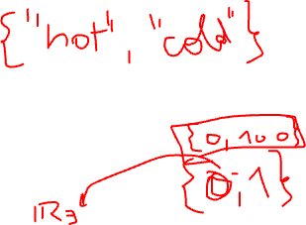
Binary Classification.
datapoint
“2021-06-01 at some FMI station”
label =
“hot” if tmp at 15:00 > 10
“cold” if … <= 10

Slide 57
Multi-Class Classification
datapoint
“2021-06-01 at some FMI station”
label =
“nice morning” if tmp at 15:00 < 10 and tmp at 10:00 > 10
“nice noon” if tmp at 15:00 > 10 and tmp at 10:00 < 10
“nice day” if tmp at 15:00 > 10 and tmp at 10:00 > 10

Slide 58
Multilabel Problems – Multitask Learning
by choosing/defining label you define the ML task !
for same data, use different labels → multiple learning tasks
multi-label class. (special case of multi-task learning)

Slide 59
Multi-Label Regression.
datapoint
“2021-06-01 at some FMI station”
label1 = tmp at 10:00
label2= tmp at 15:00

Slide 60

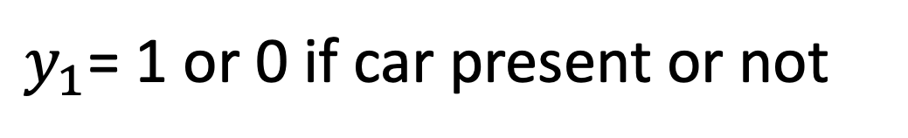
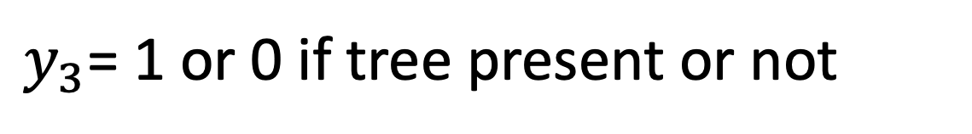
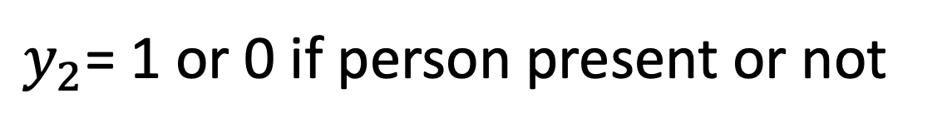
Multilabel Classification.
$y_{1}$= 1 or 0 if car present or not
$y_{2}$= 1 or 0 if person present or not
$y_{3}$= 1 or 0 if tree present or not

Slide 61
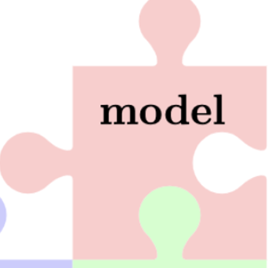
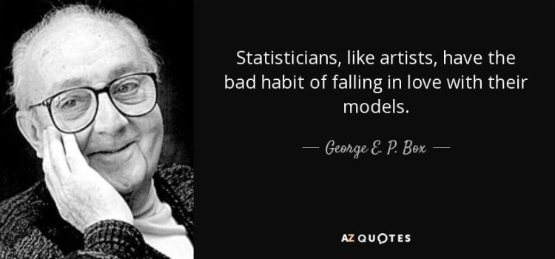

Slide 62
Machine Learning.
“learn to predict the label
of a data point solely from
its features”

Slide 63
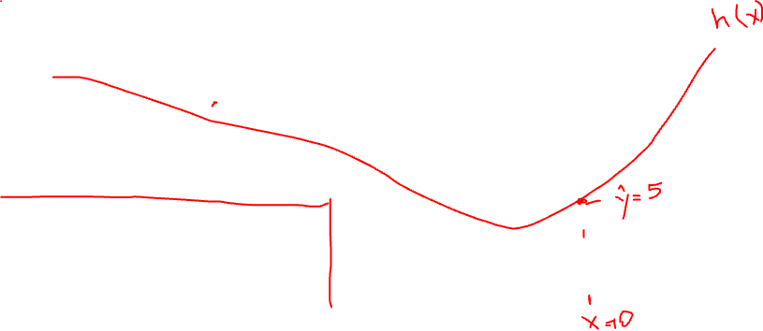

Scatterplot
label
feature

Slide 64
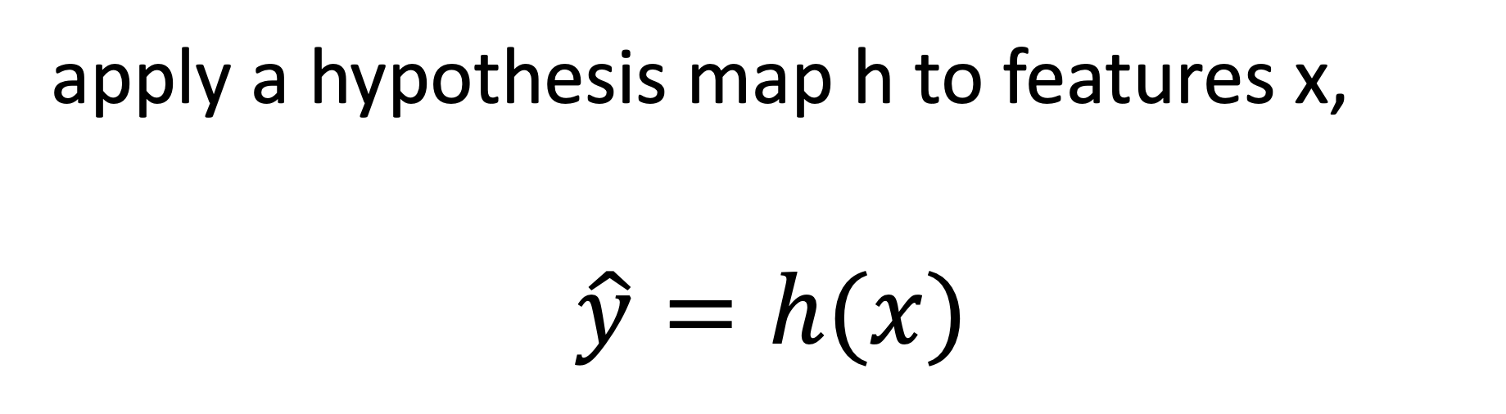
How to Predict?
apply a hypothesis map h to features x,
$$\hat{y}=h(x)$$

Slide 65
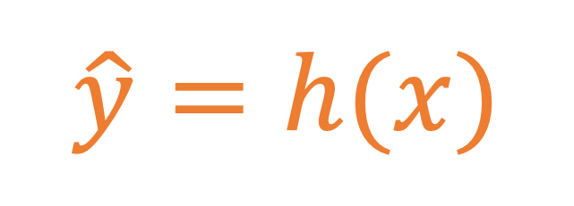
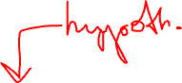
A Hypothesis.
$$\hat{y}=h(x)$$
label y
feature x

Slide 66
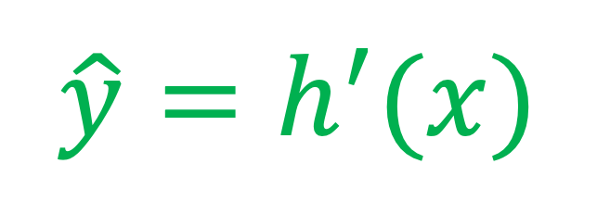
Model = Several Hypotheses.
$$\hat{y}=h(x)$$
label y
$$\hat{y}=h^{′}(x)$$
feature x

Slide 67
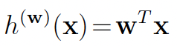
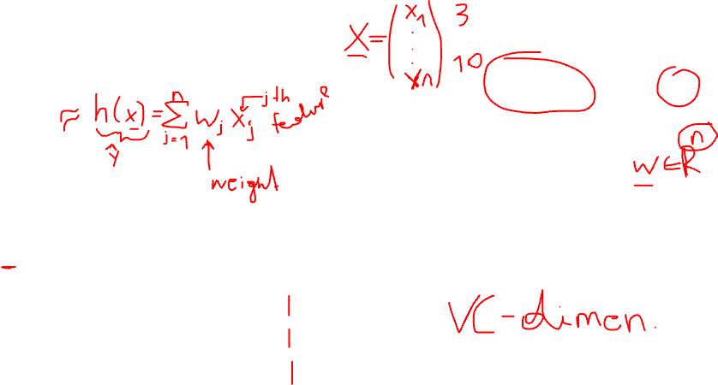
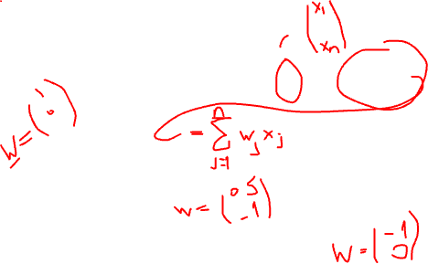
Linear Model
label y
feature x

Slide 68
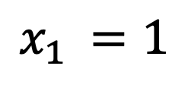
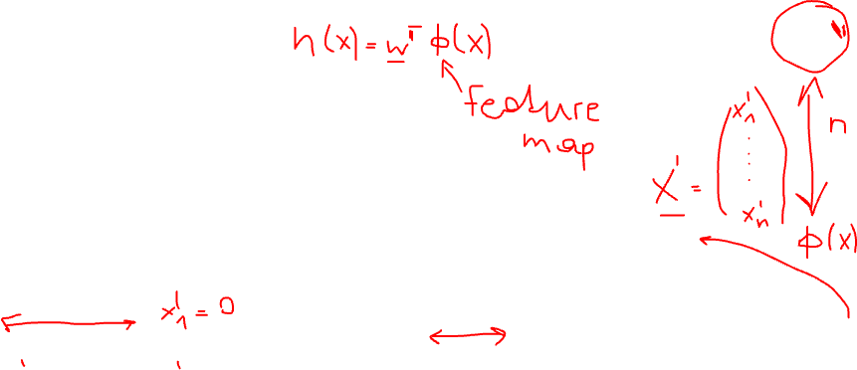
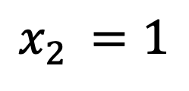
Linear Model is Versatile!
label y
feature x
$$x_{1 }=1$$
$$x_{2 }=1$$

Slide 69
Linear + Feature Map
linear map
feature map
single
feature x
h(x)

Slide 70


Polynomials
label y
more in lecture
“ERM”
feature x

Slide 71

Decision Tree
x
> w1?
label y
no
yes
w2
w3
w2
more in lecture
“Non-Parametric Models”
w3
feature x
w1

Slide 72


Artificial Neural Network
label y
x
h(x)
more in lecture
“Deep Learning”
feature x

Slide 73
Which Model To Choose?
large to contain a good hypothesis
small/simple to fit computational resources
small to avoid overfitting

Slide 74



Sufficiently Large
linear model might be to small for such data
there is no straight line that fits well the
data points here
need larger models that also contain non-linear maps
more on large (non-linear) models in Lectures
“Deep Learning” and “Non-Parametric Models”

Slide 75
Sufficiently Small (Statistically)
using too large model provokes overfitting
model fits well training data but does a very poor job outside the training data
more on overfitting in Lectures
“Model Val/Sel” and “Diagnosing ML”

Slide 76

Sufficiently Small (Comput.)
consider linear model with n parameters
fit linear model on m > n datapoints
requires to invert a “n by n” matrix ! (see Secion 4.3 of http://mlbook.cs.aalto.fi)

Slide 77


Sufficiently Simple (Comput.)
hypothesis maps h(x) should be easy to evaluate
recent MSc thesis on “Predicting Gas Valve Position”
h(x) is used for engine control
compute h(x) in real-time (while engine is running!)

Slide 78





Problem: predict the price trend of a cryptocurrency other than Bitcoin (e.g., ADA)
Datapoint: some day
Features:
Bitcoin price
Fear and Greed Index
Label: ADA’s price
lookintobitcoin.com
tradingview.com
Esther Gallego

Slide 79

Predicting future purchases
Datapoint = some customer
Features = customer attributes (age, sex, purchase history, etc.)
?
Label = interest in some (new)
product
Marko Ikävalko

Slide 80

Datapoint = A Day in the Canteen
features:
label:
https://commons.wikimedia.org/wiki/File:Suzhou_High_School-canteen.jpg
Jasu Vehtari

Slide 81

Datapoint = A Cow
Features:
Quantity of milk produced per day or over time
Temperature of the milk
Labels:
Is the cow sick or not.
Is it past its peak productin time or not.
Is it of species X or Y.
by Carlos Santos

Slide 82

ML business examples
Anne Suorsa
From finance
Regression - predicting Beta
Datapoints = daily observations of returns
From marketing
Targeted marketing campaign
Feature
Label
Datapoint
Features
Label
Feature

Slide 83



Slide 84
Which Hypothesis is Better?
$$\hat{y}=h(x)$$
label y
$$\hat{y}=h^{′}(x)$$
feature x

Slide 85


A Loss Function
$$\hat{y}=h(x)$$
label
(x’,y’)
$$L(\left(x′,y′\right);h)$$
quantitative measure of prediction error obtained
when using hypothesis h to predict label y’ of datapoint
with feature x’
feature

Slide 86





The Squared Error Loss
$${L \text{:= }\left(\hat{y}−y\right)}^{2}$$
$$y$$
predicted label $\hat{y}=h(x)$

Slide 87




The Absolute Error Loss
L$\text{:}\text{=} \left|\hat{y}−y\right|$
predicted label $\hat{y}=h(x)$
$$y$$

Slide 88



Loss Functions for Binary Classification
label y = “cat”
h(x) = “dog”
features x = pixels
Loss = 100

Slide 89
Loss Functions for Binary Classification
label y = “cat”
h(x) = “cat”
features x = pixels
Loss = 0

Slide 90

Classifiers
consider label values either “cat” or “dog”
features vector x = pixels values
can we use linear hypothesis maps h(x)?
YES!
use sign h(x) to classify: h(x) > 0 → “dog”
use |h(x)| as confidence measure

Slide 91

Loss Functions for Binary Classification
more on this in lecture “Classification”

Slide 92
Which Loss Function ?
statistical aspects (should favour “reasonable” hypothesis)
computational aspects (must be able to minimize them)
interpretation (what does log-loss = -3 mean ?)
…..choosing a suitable loss function is often non-trivial !

Slide 93

Recent Paper about Coming up with a Good Loss Function
https://arxiv.org/pdf/2111.09406.pdf

Slide 94
Main Components of ML
data
model
loss

Slide 95
Landscape of ML Methods
loss
data
linear regression
kNN
decision tree
logistic regression
k-means
model

Slide 96

Three Views on Machine Learning
“Data View”
“Model View”
label
w1
w1
feature
“Loss View”
average loss
w1

Slide 97
Three Main Flavours of ML
supervised ML (use labeled data to imitate teacher)
unsupervised ML (no labeled data needed)
reinforcement learning (learn while collecting data)

Slide 98

Supervised Learning
more on this in lecture:
“ERM”, “Classification”, “Model Val/Sel”,
“Non-Parametric”, “Deep Learning”
label y
$$\hat{y}=h(x)$$
feature x

Slide 99
Unsupervised Learning
more on this in Lecture
“Clustering”, “Feature Learning”
label of datapoint = cluster assignment or
nearby subspace

Slide 100


Reinforcement Learning
label = “optimal steering
direction”
more on this in
ELEC-E8125 - Reinforcement learning.

Slide 101

Wrap Up
data points characterized by features and label
features $≈$ low-level properties
labels $≈$ high-level properties (quantity of interest)
GOAL of ML: learn a hypothesis h such that h(x) $≈y$
ML model = comp. tractable subset of possible hypothesis maps h(x)
prediction error y-h(x) quantified using a loss function

Slide 102

Next Lecture “Empirical Risk Minimization”
GOAL of ML: Learn hypothesis h(.) such that y $≈$ h(x) for any data point (x,y).
what exactly is “any data point” ?

Slide 103

What is ML ?
informal: learn hypothesis out of a hypothesis space or “model” that incurs minimum loss when predicting labels of datapoints based on their features
“training error”
see Ch. 4.1 of mlbook.cs.aalto.fi

Slide 104




hypothesis h(x) that
minimizes $E_{t}$
$$x^{(i)},y^{(i)}$$
label y
training error
$E_{t}=\frac{1}{3}\sum_{i=1}^{3}{({\hat{y}}^{\left(i\right)}−y^{\left(i\right)})^{2}}$
validation error
$E_{v}=({\hat{y}}^{\left(4\right)}−y^{\left(4\right)})^{2}$
feature x

Slide 105
Data and Model Size
training set
m
hypospace/model
nr. of features n
crucial parameter is the
ratio d/m
d
Notes:
The sample size m is the nr. of different datapoints in the training set

Slide 106
training error
validation error
“critical value” (d/m=1)
d / m
adjust model and/or data to reach

Slide 107
Privacy-Friendly Machine Learning

Slide 108
vaccine hesitancy ?

Slide 109
label=hesitancy
each datapoint has
unique feature!
feature=age

Slide 110
label=hesitancy
quantize feature
values!
feature=age

Slide 111
label=hesitancy
quantized features
non-unique!
feature=age

